Slide 1


Corporate Classifieds
Your personal Online Exchange

Slide 2

OUR TEAM
Nikita Dubey
(2153614)
Sudipta Bhattacharjee
(2153851)
Satya Sharma
(2153940)
Pandiselvi S
(2153739)
© 2022 Cognizant

Slide 3





CORPORATE CLASSIFIEDS IN A SHELL
Offer microservice
Classifieds Portal
Authentication microservice
Employee microservice
USER
(medium)
Points microservice
© 2022 Cognizant

Slide 4








REQUIREMENT ANALYSIS
© 2022 Cognizant

Slide 5
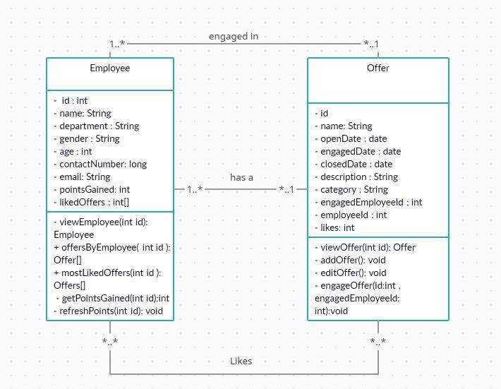
CLASS DIAGRAM
© 2022 Cognizant

Slide 6
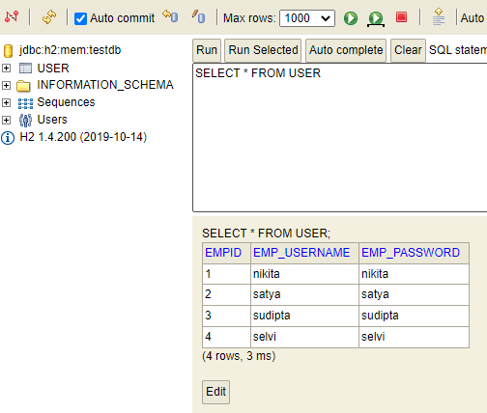
H2-Console TABLES
USER table contains USERNAME and PASSWORD

Slide 7
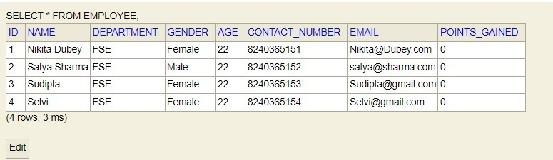
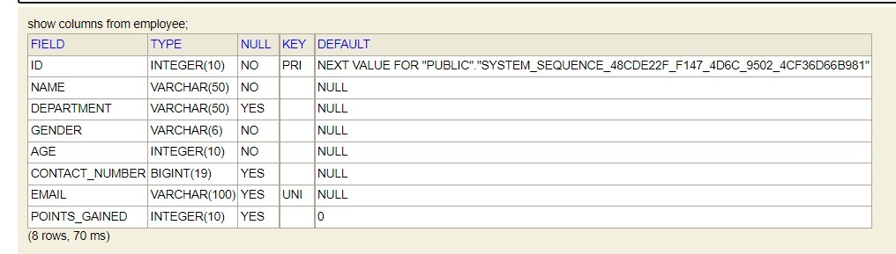
H2-Console TABLES(CONTINUED)
EMPLOYEE TABLE

Slide 8
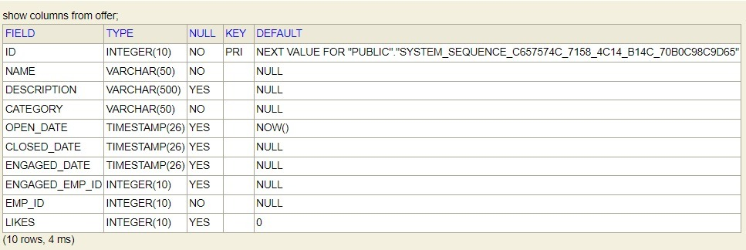
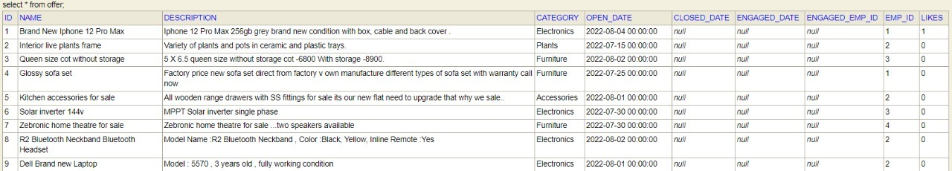
H2-Console TABLES(CONTINUED)
OFFER TABLE

Slide 9
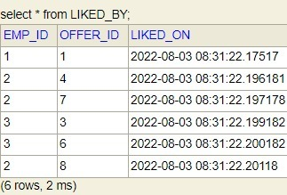
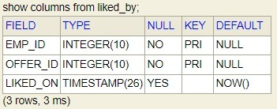
H2-Console TABLES(CONTINUED)
LIKED BY TABLE (To describe many to many relationship between offers and employee)

Slide 10





DEVELOPMENT & DESIGNING

Slide 11







MICROSERVICES
Auth microservice - to handle authentication of the employee
Employee microservice - to handle employee related services
Offer microservice - to handle offer related services
Points microservice - to refresh points gained by the employee

Slide 12
AUTH MICROSERVICE

Slide 13




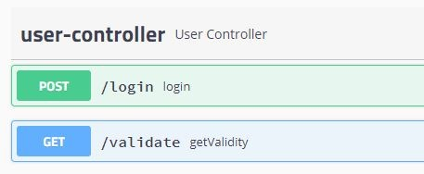
REST ENDPOINTS
/login - to log in the employee and generate jwt token
/validate - to validate the jwt token
A look at swagger.html for auth microservice

Slide 14
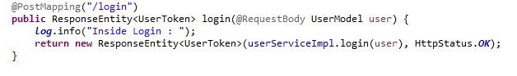
Rest Controller (a gist)
One of the Post mappings of the rest controller (to login the user)
Rest controller calls the UserServiceImpl.java where all the necessary details are implemented

Slide 15
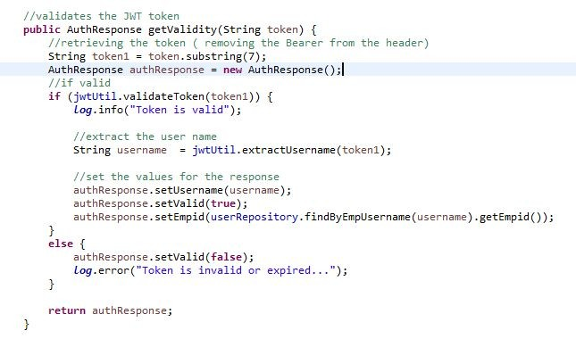
AUTH SERVICE

Slide 16
EXCEPTION HANDLING
Rest Exception handler - to handle all the
exceptions that occurs in the microservice with proper status code
UnauthorizedException - thrown when the user is invalid.

Slide 17
EMPLOYEE MICROSERVICE

Slide 18
REST ENDPOINTS
/employee/viewProfile/{id} - to view employee details by id parameter
/employee/viewEmployeeOffers/{id} - to view
all the offers posted by the employee through id parameter
/employee/viewMostLiked/{id} - to view top 3
most liked offers of the employee by id parameter

Slide 19
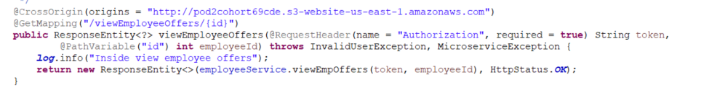
Rest Controller (a gist)
One of the Get mappings of the rest controller (to view employee offers)
Rest controller calls the employeeServiceImpl.java where all the necessary details are implemented

Slide 20
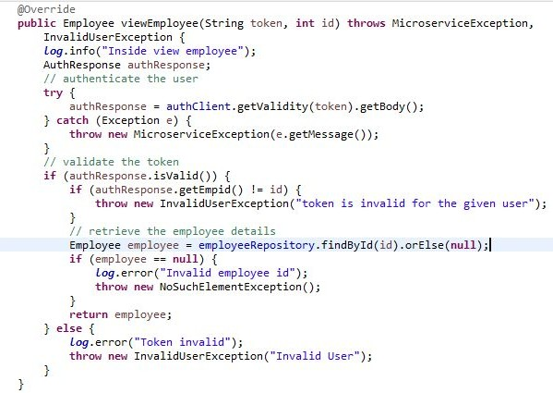
EMPLOYEE SERVICE
AuthResponse{
Int Empid;
String username;
boolean Isvalid;
}

Slide 21
EXCEPTION HANDLING
Employee Exception handler - to handle all the
exceptions that occurs in the microservice with proper status code
InvalidUserException - thrown when the user is unauthorized
MicroserviceException - thrown when there is an error in the communicated microservice.

Slide 22
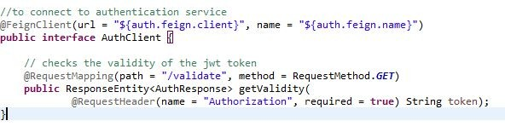
FEIGN CLIENTS
Auth client - to communicate with the authentication microservice
Offer client - to communicate with the offer microservice
Interface of AuthClient

Slide 23
OFFER MICROSERVICE

Slide 24
REST ENDPOINTS
/offer/addOffer - to post a new offer
/offer/editOffer - to edit an existing offer
/offer/engageOffer - to engage an offer
/offer/getOfferByCategory - to filter offers by category
/offer/getOfferByPostedDate - to filter offers by posted date
/offer/getOfferByTopLikes - to retrieve top 3 most liked offers
/offer/getOfferDetails/{id} - to retrieve offer by id parameter

Slide 25
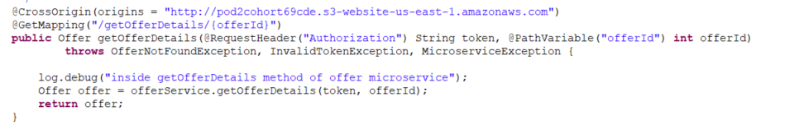
Rest Controller (a gist)
One of the Get mappings of the rest controller (to get the details of an offer by offer id)
Rest controller calls the offerService.java where all the necessary details are implemented

Slide 26
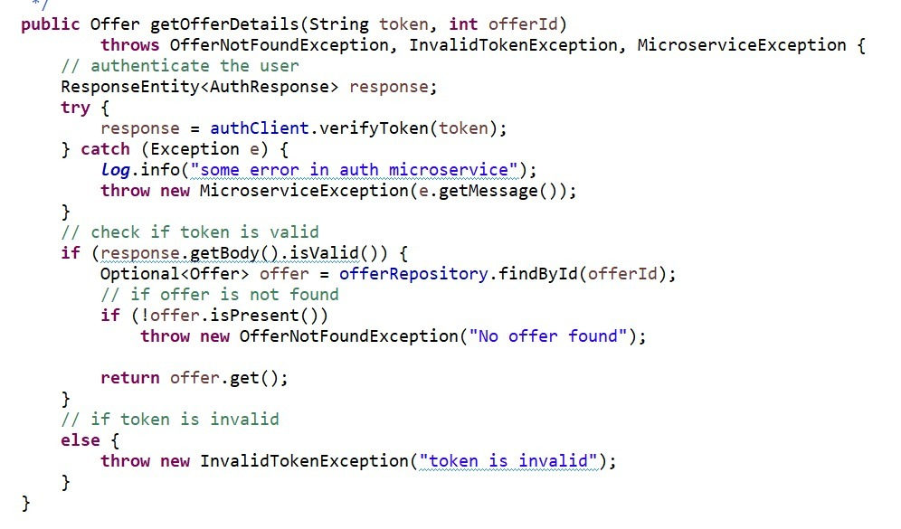
OFFER SERVICE

Slide 27
EXCEPTION HANDLING
Global Exception handler - to handle all the exceptions that occur in the microservice with proper status code
EmployeeNotFoundException - thrown when no employee is found
ImproperDateException - thrown when an improper date is passed
InvalidTokenException - thrown when the jwt token is invalid
MicroserviceException - thrown when the communicated microservice is not working
OfferNotFoundException - thrown when no offers are found

Slide 28
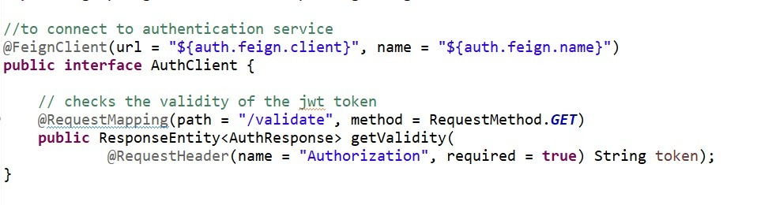
FEIGN CLIENTS
Auth client - to communicate with the authentication microservice
Employee client - to communicate with the employee microservice
Interface of AuthClient

Slide 29
POINTS MICROSERVICE

Slide 30
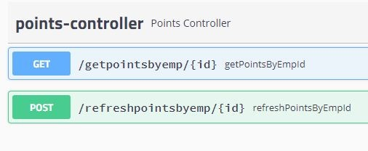
REST ENDPOINTS
/getpointsbyemp/{id} - to get points gained by the employee
/refreshpointsbyemp/{id} - to refresh the points of the employee
A look at swagger (for points

Slide 31
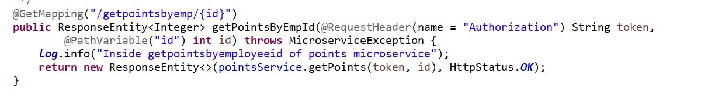
Rest Controller (a gist)
One of the Get mappings of the rest controller (to get the points gained by the employee)
Rest controller calls the pointsServiceImpl.java where all the necessary details are implemented

Slide 32
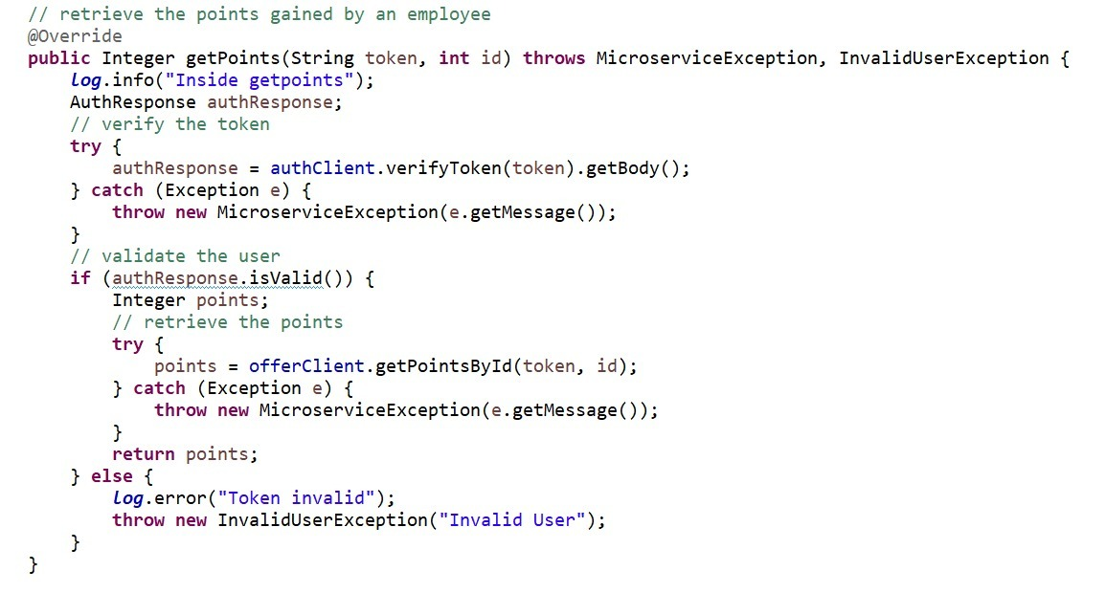
POINTS SERVICE

Slide 33
EXCEPTION HANDLING
InvalidUserException - thrown when the jwt token is invalid
MicroserviceException - thrown when the communicated microservice is not working
PointsExceptionHandler - to handle all the exceptions thrown by the rest controller

Slide 34
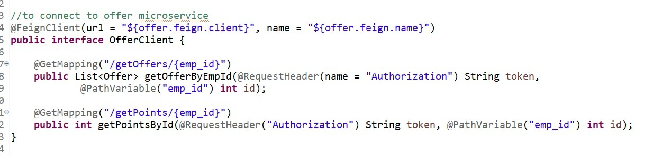
FEIGN CLIENTS
Auth client - to communicate with the authentication microservice
Employee client - to communicate with the employee microservice
Offer client - to communicate with the offer microservice
Interface of Offer Client

Slide 35
TESTING

Slide 36
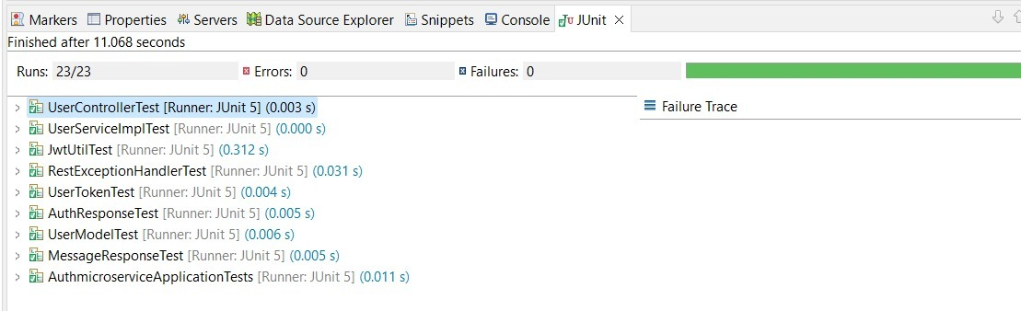
AUTH MICROSERVICE
AuthMicroserviceApplicationTests
UserControllerTest
RestExceptionHandlerTest
JwtUtilTest
ModelTests
UserServiceImplTest
There are 23 test cases and all of them pass successfully

Slide 37
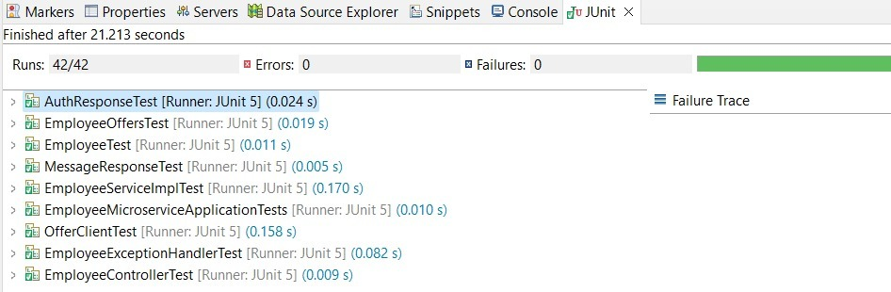
EMPLOYEE MICROSERVICE
EmployeeMicroserviceApplicationTests
OfferClientTest
EmployeeControllerTest
EmployeeExceptionHandlerTest
ModelTests
EmployeeServiceImplTest
There are 42 test cases and all of them pass successfully

Slide 38
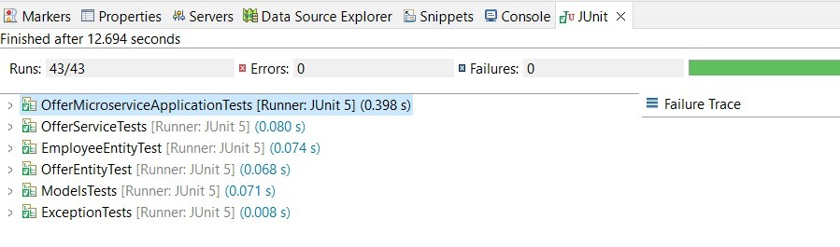
OFFER MICROSERVICE
EmployeeEntityTests
ExceptionTests
OfferEntityTests
OfferServiceTests
ModelTests
There are 43 test cases and all of them pass successfully

Slide 39
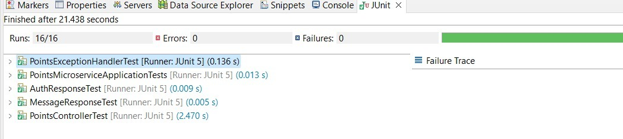
POINTS MICROSERVICE
PointsMicroserviceApplicationTest
PointsControllerTests
PointsExceptionHandlerTests
ModelTests
There are 16 test cases and all of them pass successfully

Slide 40
USER INTERFACE

Slide 41
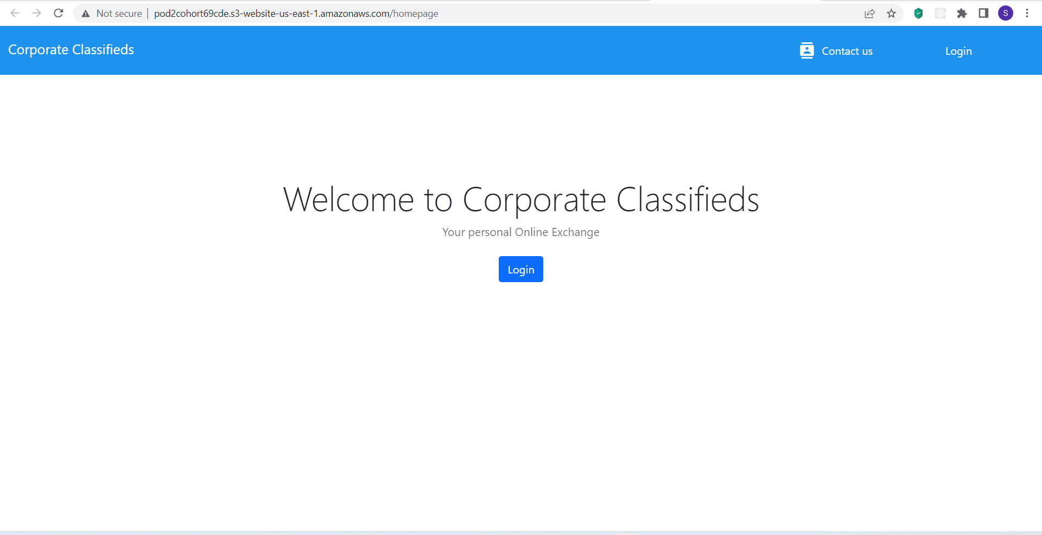
LANDING PAGE

Slide 42
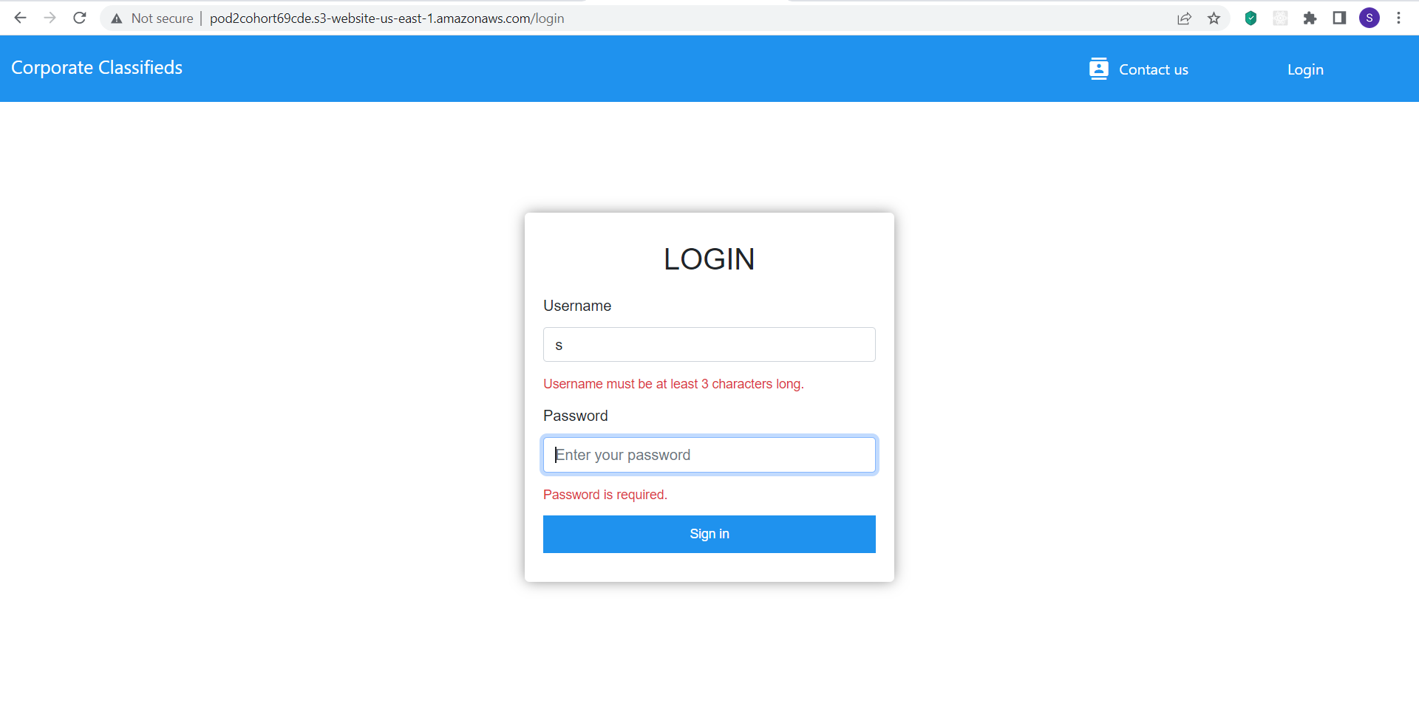
LOGIN PAGE
Proper validation for each field

Slide 43
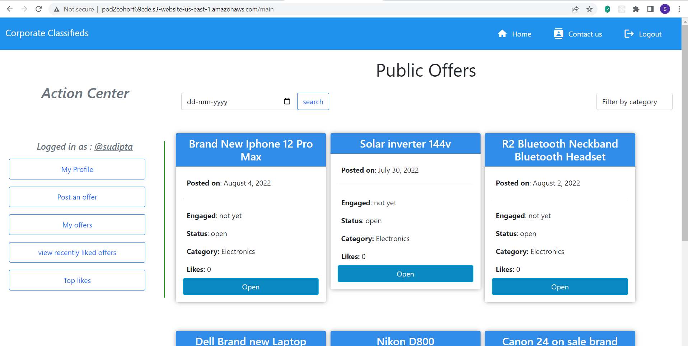
MAIN PAGE

Slide 44
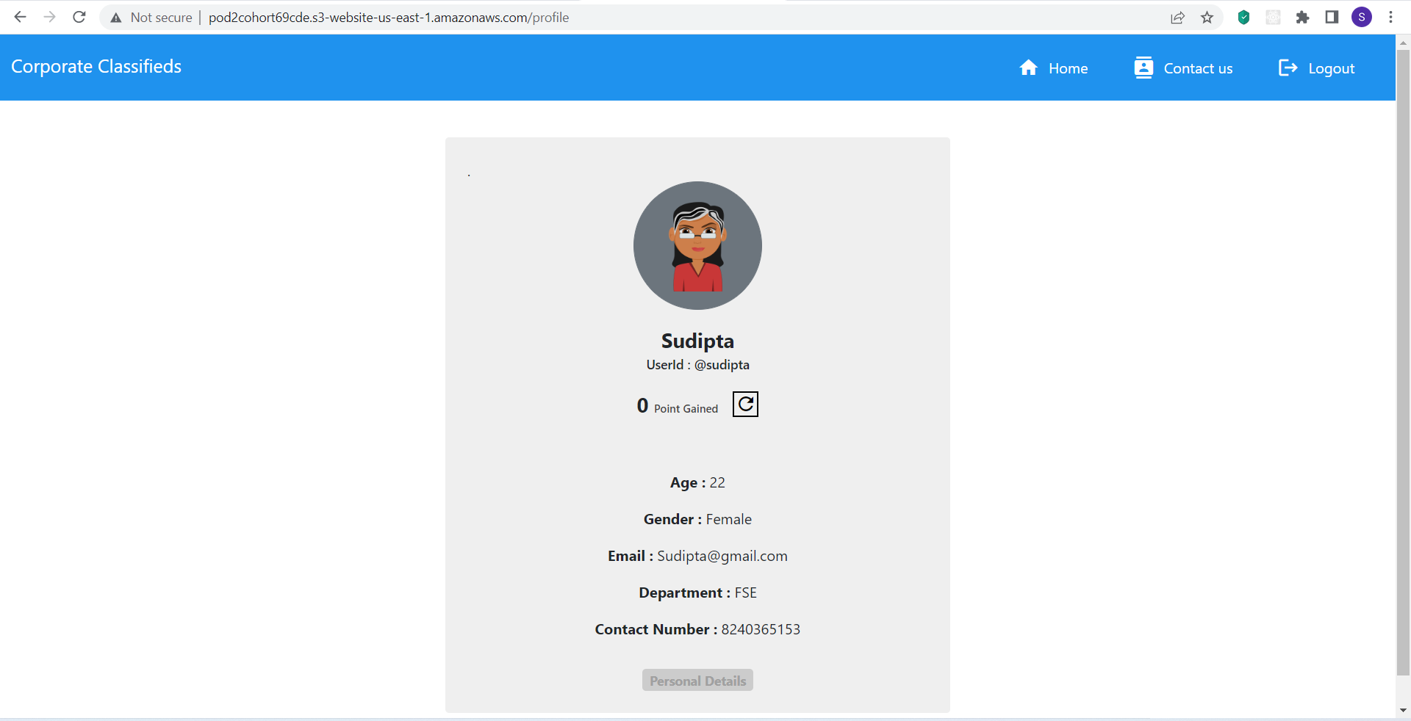
PROFILE PAGE

Slide 45
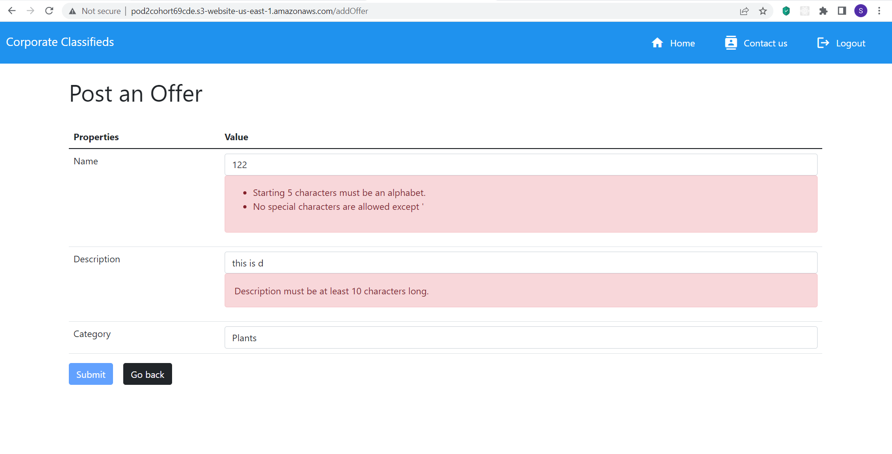
POST OFFER PAGE

Slide 46
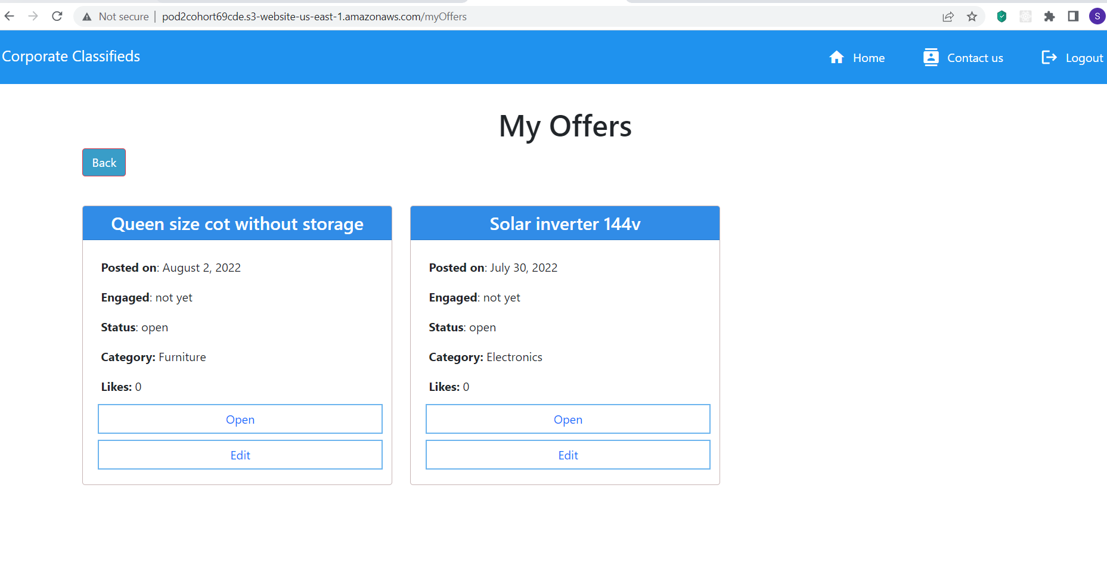
MY OFFERS PAGE

Slide 47
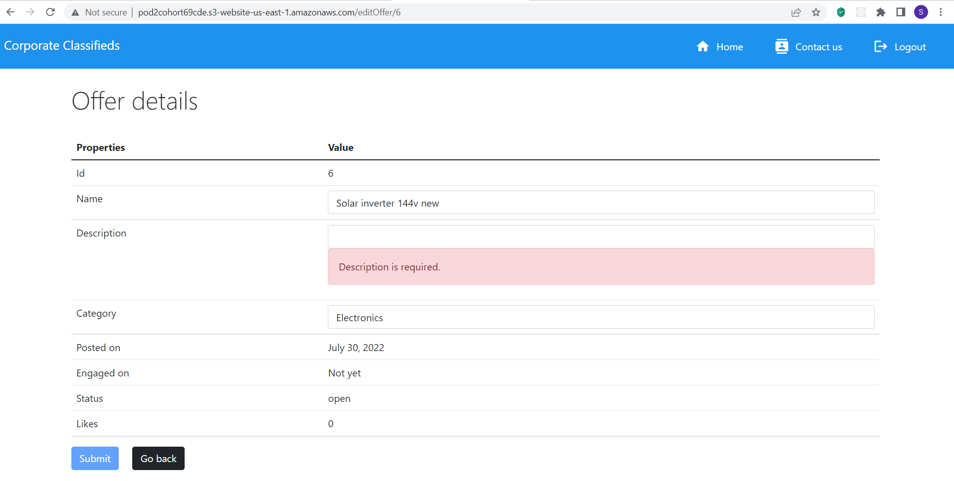
EDIT OFFER PAGE

Slide 48
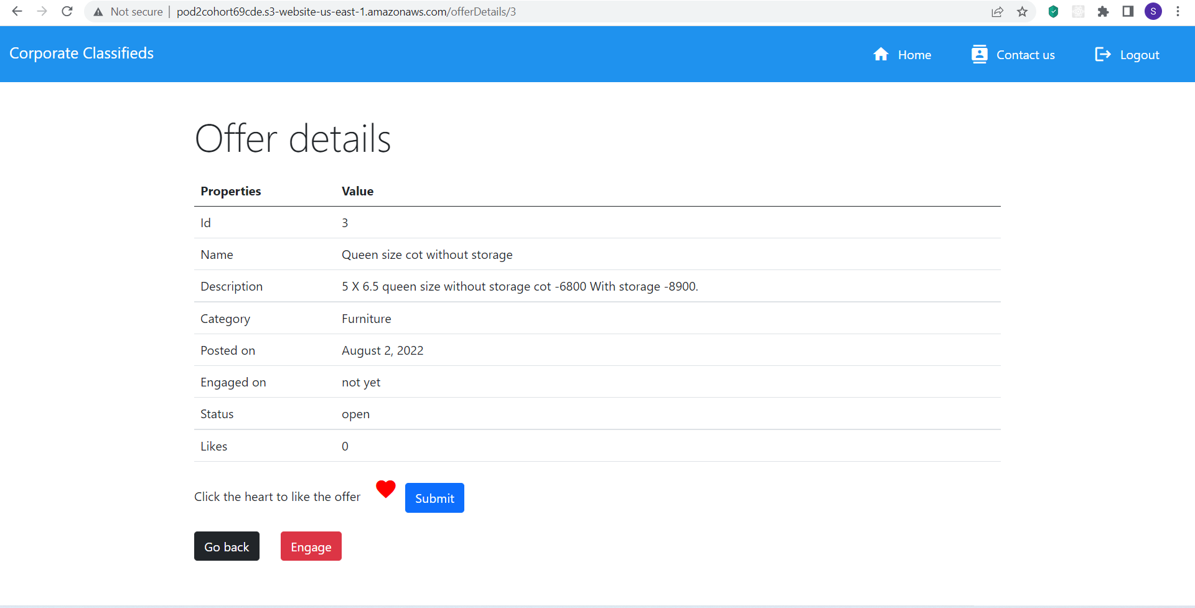
OFFER DETAILS PAGE

Slide 49
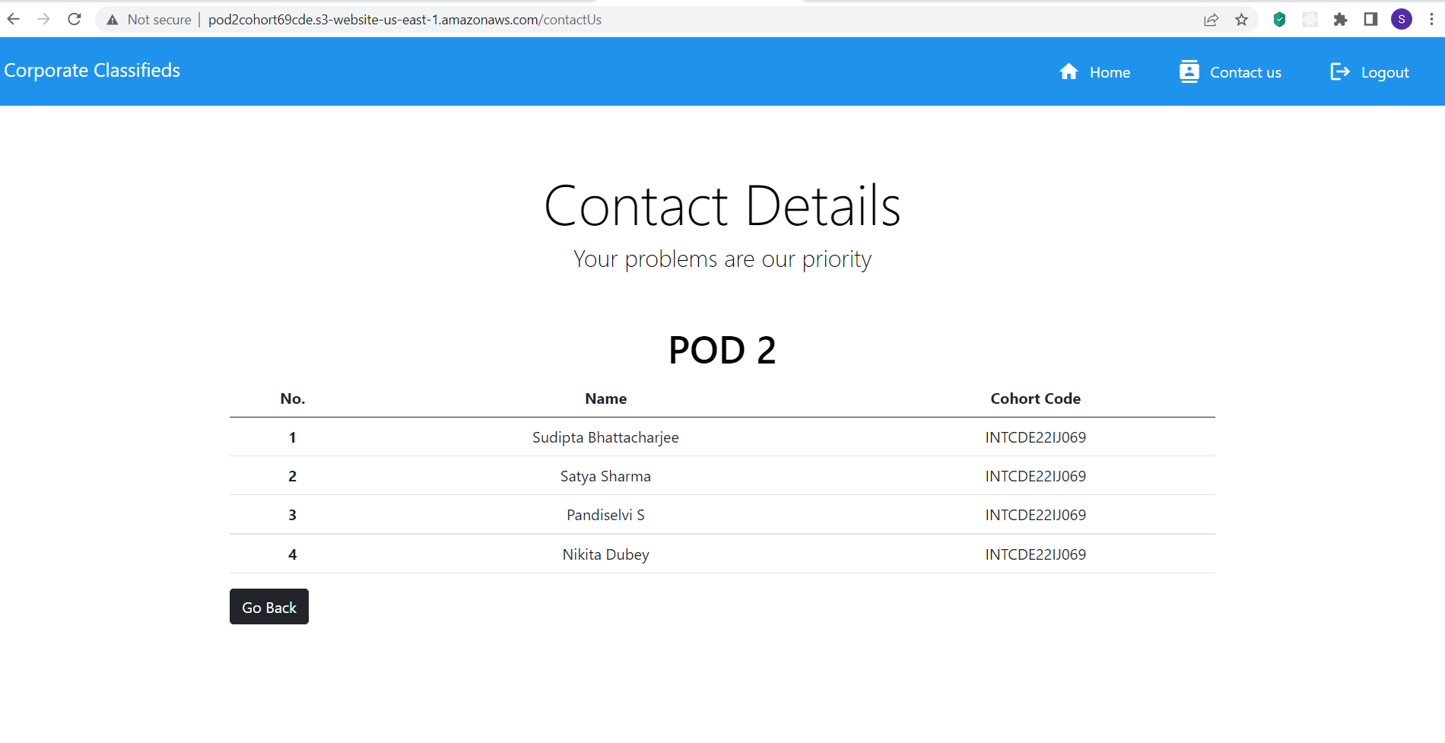
CONTACT US PAGE

Slide 50
DEPLOYMENT

Slide 51
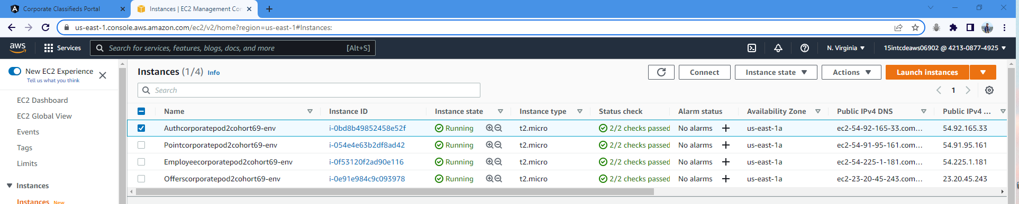
All Microservice Running Concurrently on AWS

Slide 52
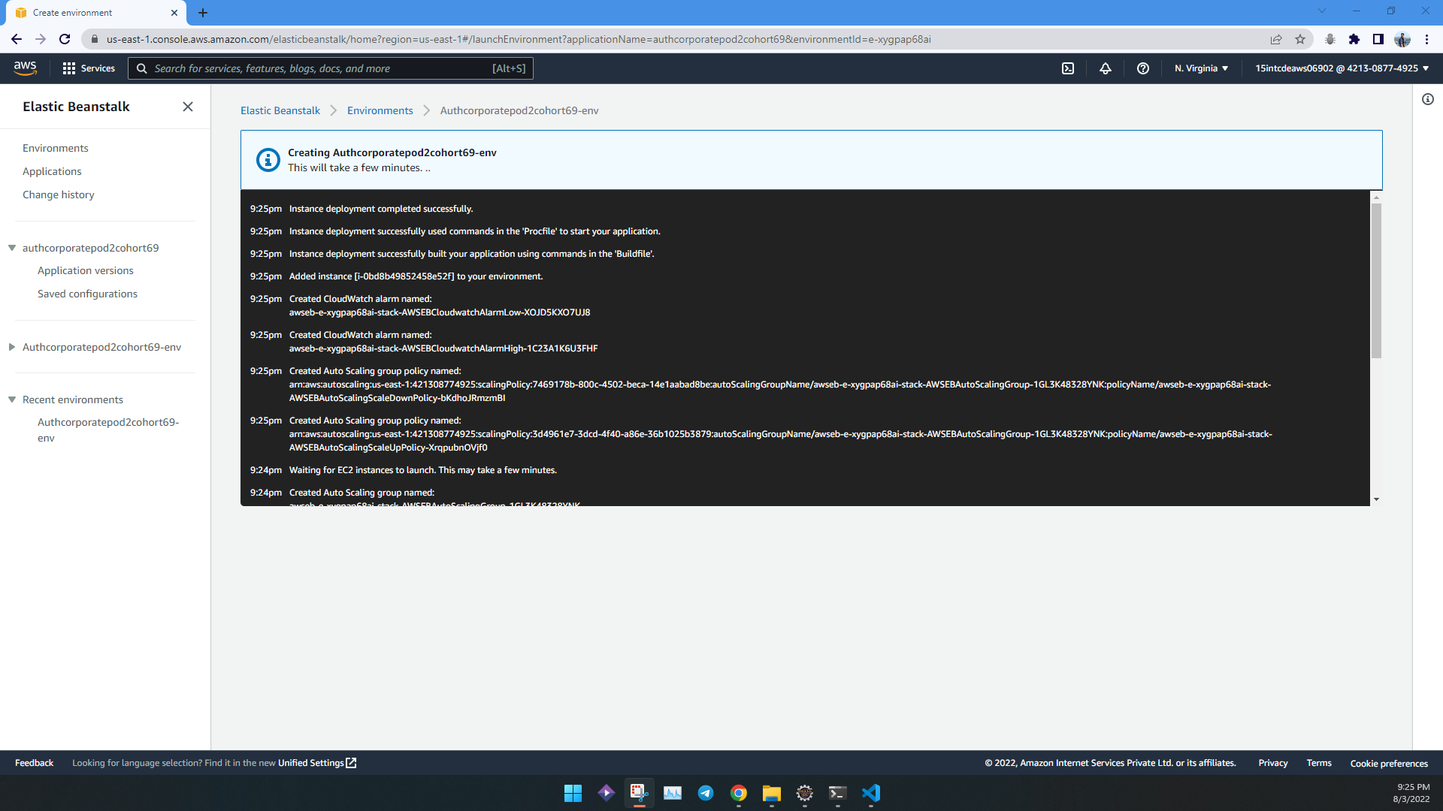
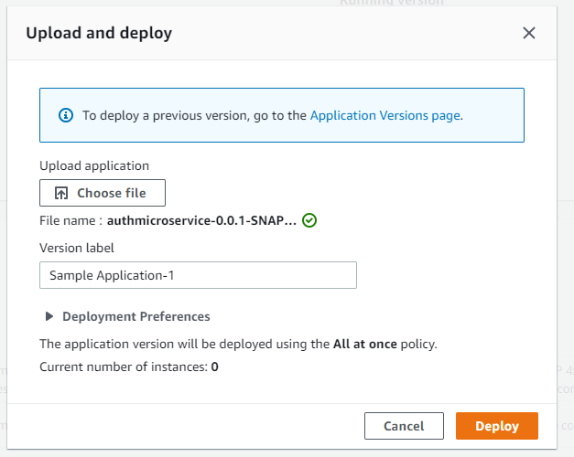
AUTH MICROSERVICE
Build Stage
Deploy Stage

Slide 53
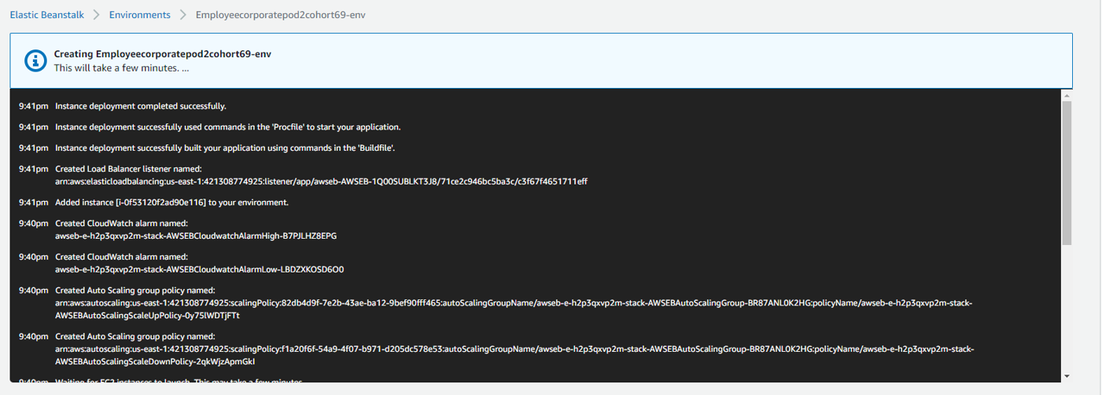
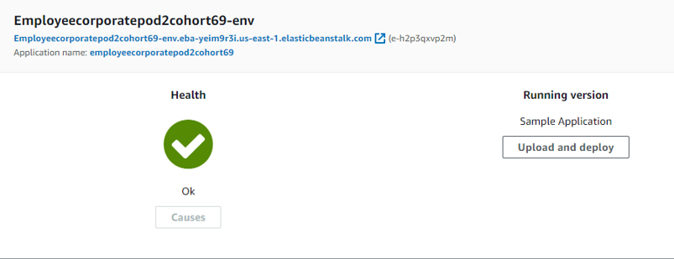
EMPLOYEE MICROSERVICE
Build Stage
Source Stage

Slide 54
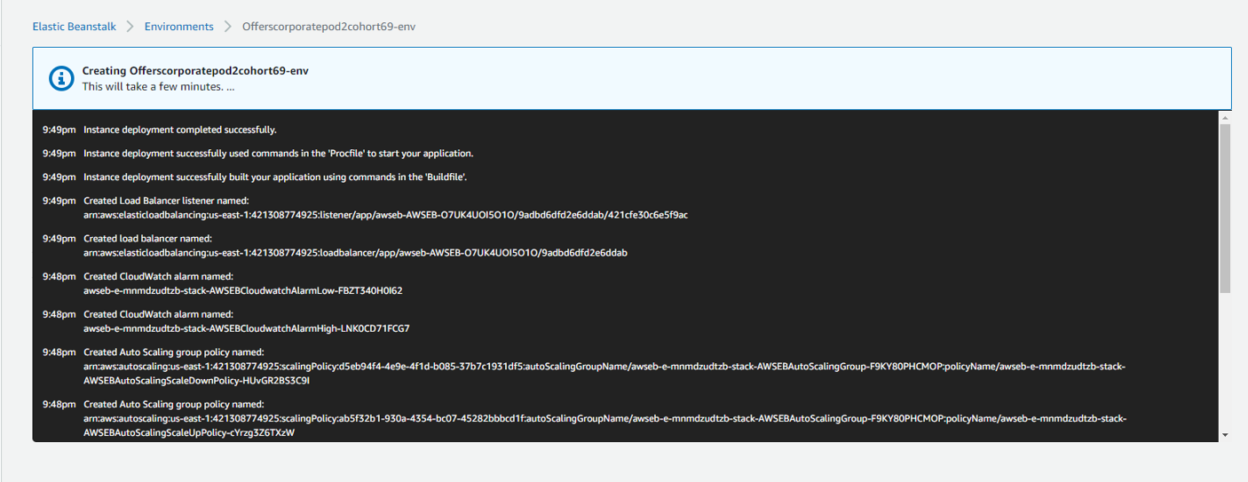
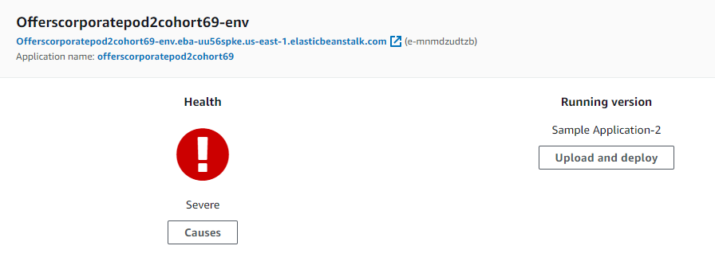
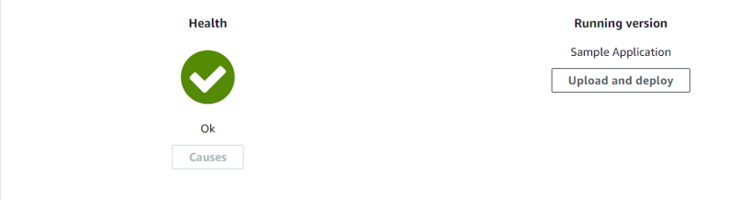
OFFER MICROSERVICE
Build Stage
Source Stage

Slide 55
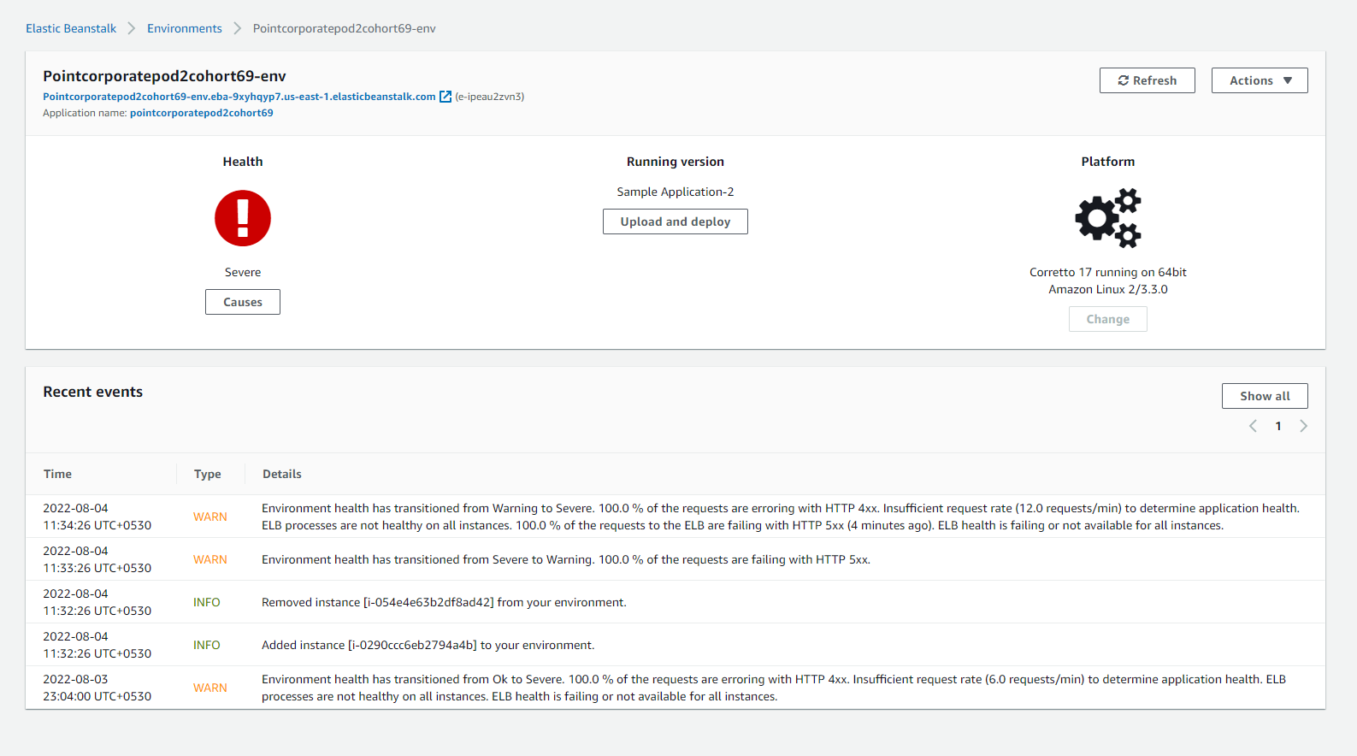
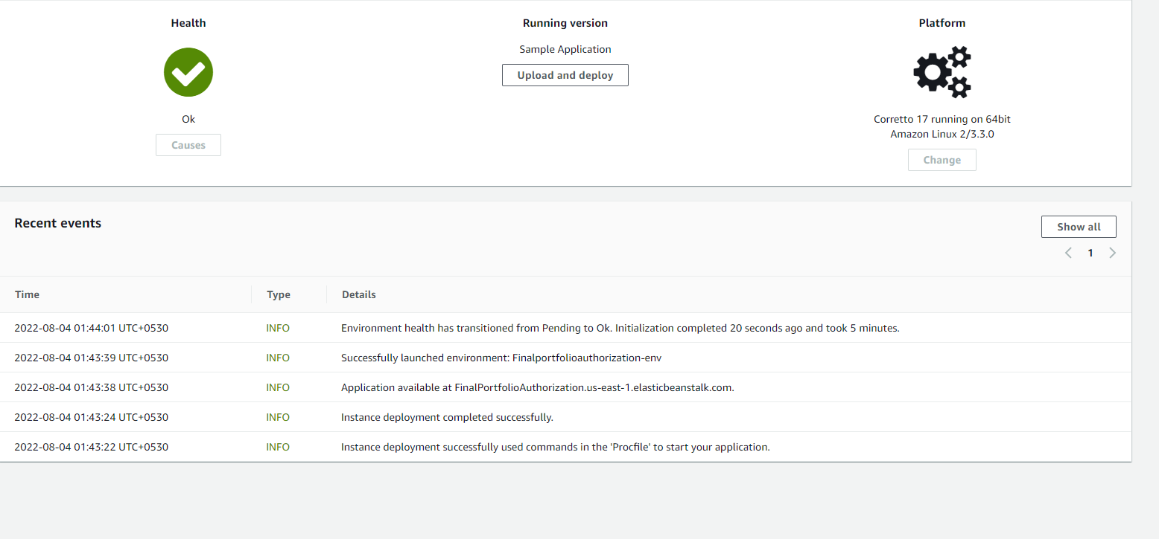
POINTS MICROSERVICE
Build Stage
Deploy Stage

Slide 56
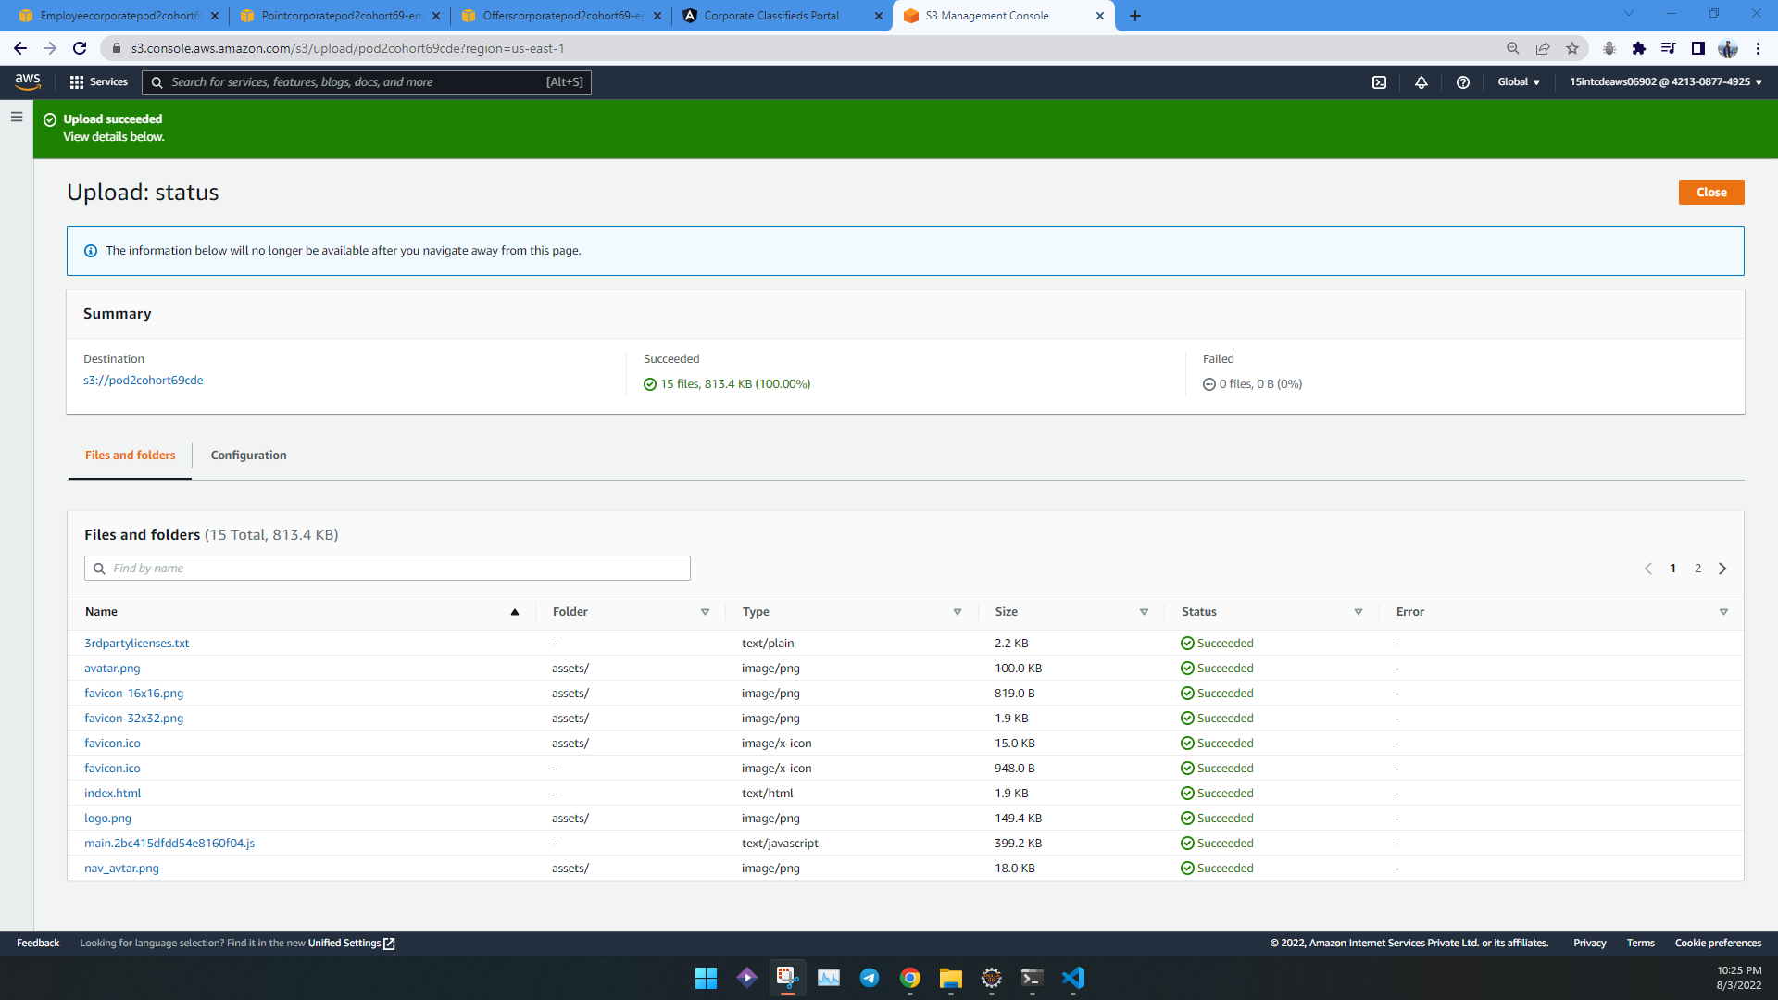
Angular / Front End Deployed On S3 Bucket

Slide 57
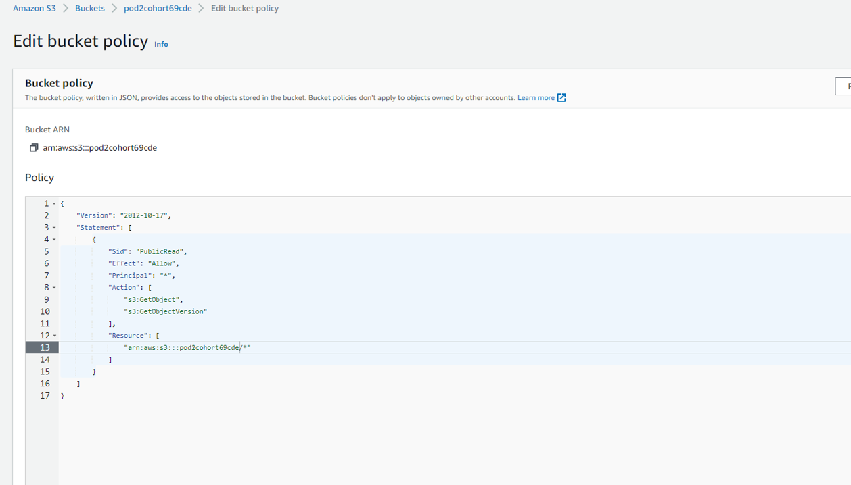
Editing bucket Policy to make give it read only access to anonymous user

Slide 58
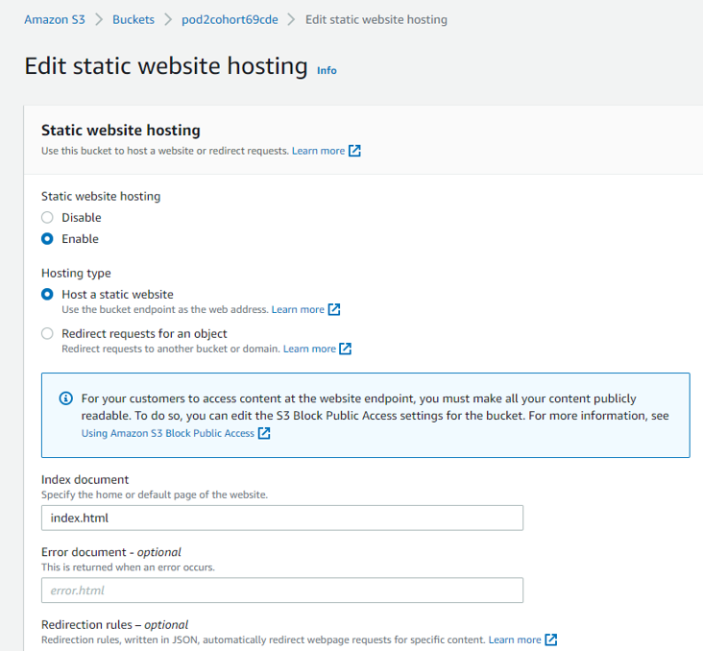
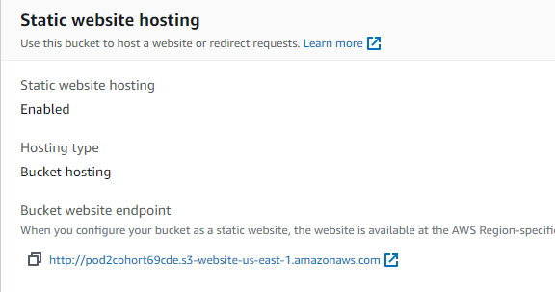
Enabling Static Hosting for S3 Bucket
http://pod2cohort69cde.s3-website-us-east-1.amazonaws.com/

Slide 59









THANK YOU

